Slide 1

NL2Vul: Natural Language to Standard Vulnerability Score for Cloud Security Posture Management
Muhammed Fatih Bulut, Jinho Hwang§ IBM T.J. Watson Research Center {mfbulut, jinho}@us.ibm.com
Notes:
NOTE:
To change the image on this slide, select the picture and delete it. Then click the Pictures icon in the placeholder to insert your own image.

Slide 2
STUDY OBJECTIVES
CSPM cover end to end security of application from development to deploymennt.
A framework to train a model with NVD dataset and extend the model using transfer learning with small-sized dataset for other security problem.
Investigation of well known DNNs such as CNN, LSTM, transformers (BERT) for predecting severity of a given vulnerability.
To be able to predict vulnerability score for a different data source.

Slide 3
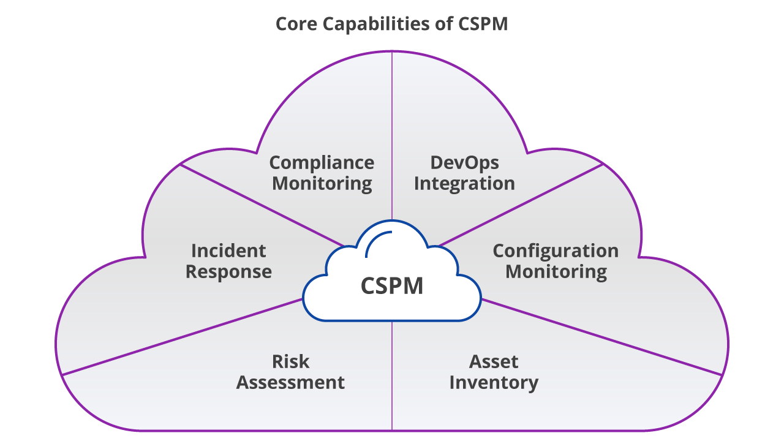
Research Motivation
To address the challenge of analyzing and quantifying the risk of vulnerabilities in multi cloud environment.
Increasing vulnerabilities in NVD vastly in recent years, 144k as late 2020
Predict vulnerability with minimal human effort.
Improve the efficiency and accuracy of CSPM tools.

Slide 4
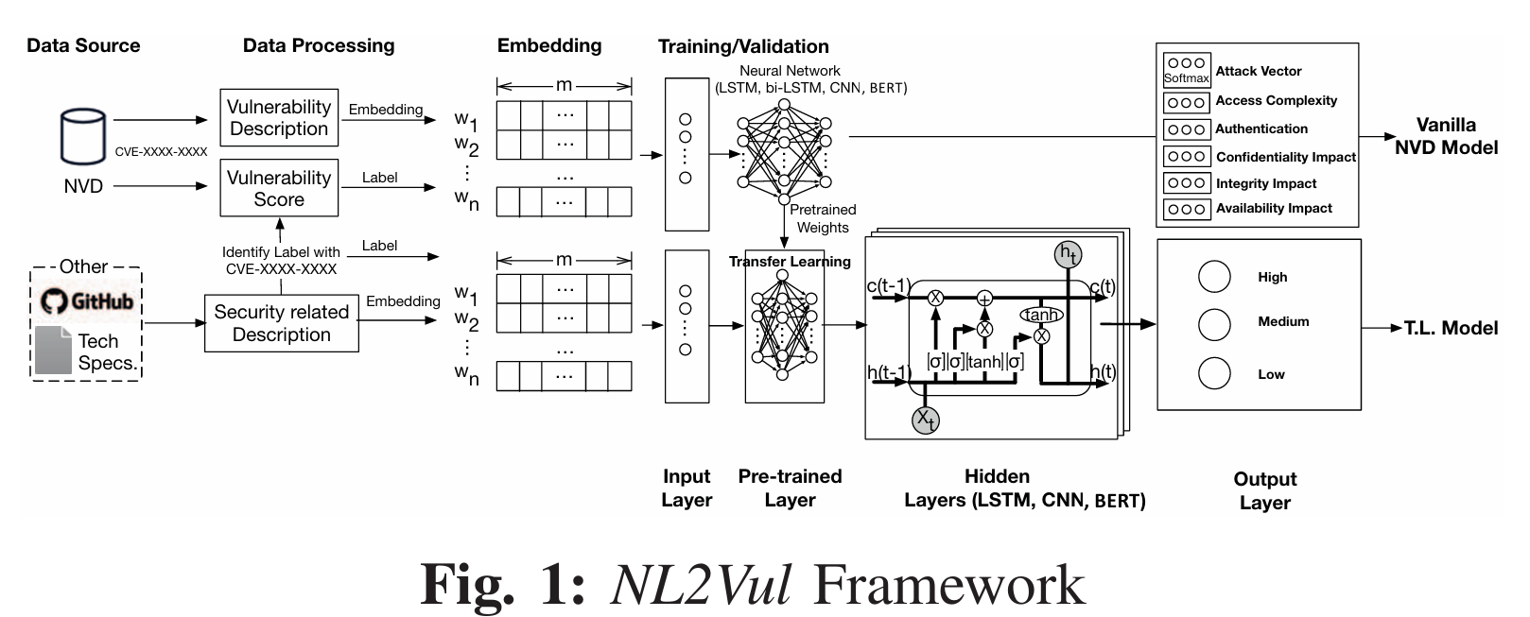
NL2Vul Architecture
Input Layer:
Pre-trained Layer:
01
02
Word embedding captures context of a vul, semantic, similarity with other word.
Distinguish between word and phrase.
Experiment 3 different embeddings. Word2vec, word2vec-p(google), BERT(TensorFlow)
Apply pre-trained model To ternsfer learned knowledge from base dateset.
Base model is NVD model. NL2Vul removes the last layer of NVD and train with new data.

Slide 5
NL2Vul Architecture
Hidden Layer:
03
04
Output Layer:
Resulting classification which capture different metrics in CVSS
It render 6 different metrics for calculating vul score.
Text classification. Use 3 architect
CNN: Computer Vision related work. Object, face, medical image
RNN: Use LSTM to learn long text
BERT: similar to RNN. Handle sequential data. Text is not required. A Transfer model.

Slide 6
Methodology
Base score metrics of CVSS consist of 6 dimensions. Each have 3 values.
Based on the selected metrics CVSS define a formula to calculate 0 to 10 or low, medium, high.
Input data is text and output data both text and categorical.
For numerical we use Mean Absulate value (MAE) and Mediun Absulate Value (MdAE)
Use F-score to calculate categorical value. Macro, Micro, weighted.
70% as training, 15% as validation, 15% as testing
Validation data enables us to improve training
Experiment on max 250 epochs with a batch size of 64.
It monitor the improvement in validation sets.
If no improvements that is more than 0.001 MAE for 10 consecutive epochs, it assume that the model has converged and stop training.
Testing chart

Slide 7
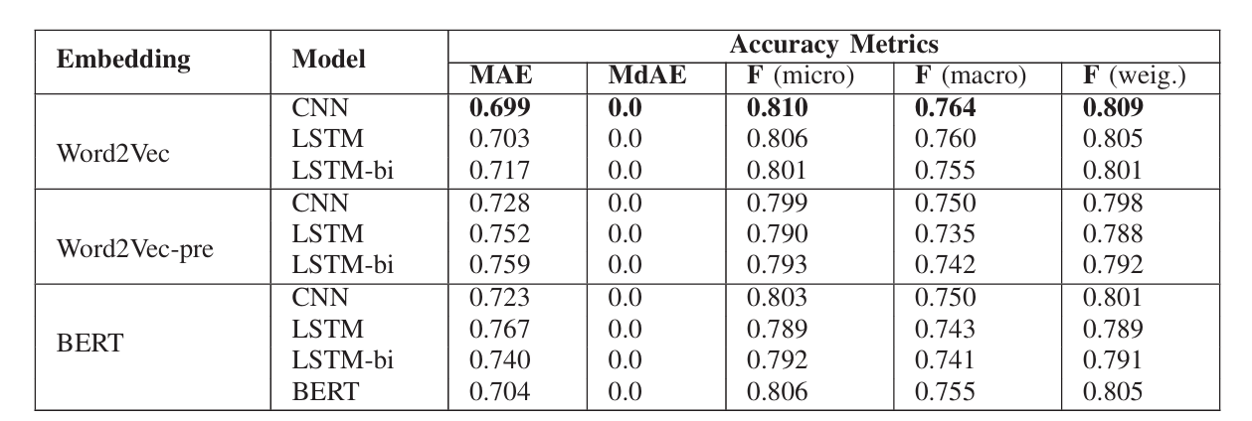
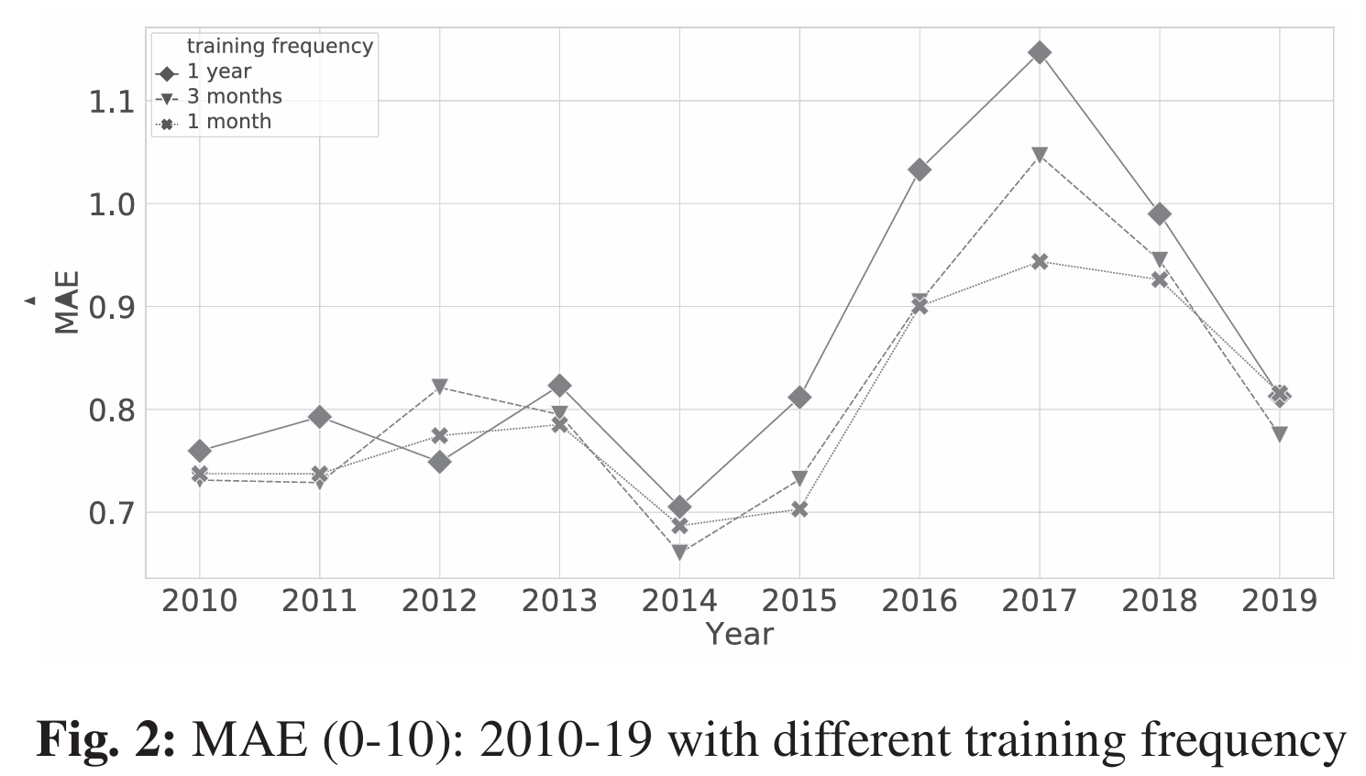
Performance and Evaluation
CNN achieved the highest score in this experiments.
Succed for LSTM, LSTM-bi, BERT architecture
Obtain best result with word2vec which train using the training data of NVD
For vanila NVD model we obtain great performance of MAE of 0.699, MdAE of 0 and F-score of (micro): 0.81, (macro): 0.764, and (weighted): 0.809
High F-score indicate that the model predict correct ans.
Look at 10 years data. Past data for training and validation. Recent data as testing.

Slide 8
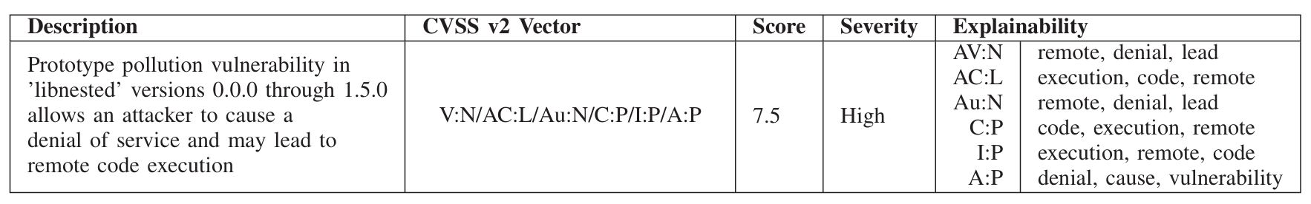
Performance and Evaluation
NL2Vul framework use DNN and transfer learning to predict vulnerability score from given textual data.
The base model learn from the vanila NVD dataset as a pre-trained
We obtain 81% accuracy in predicting the severity of a given vulnerability.
NL2Vul is effective for small dataset as compare to traditional machine learning approach in two use case: compliance techspec documents and gitHub issues.
Able to quckly assess the vulnerability score
Vulnerability Description

Slide 9

Subsequent Advancements
Data Source
Improve learning
Integrate further trained transfer learning techniques to increase adaptibility.
Enhanced data source and incorporate various data better accuracy.
CSPM tools
Update with real time
Develop with real time data and kepp update updated vulnerability score.
To automate and real time assesment keep integrate existing CSPM tools.

Slide 10
Thank you for your concern
#FREE PALESTAIN
#BOYCOTT
#ALL EYES ON RAFA
Feel free to propose your queries.

